Slide 1

Introduction to Python for Data Science

Slide 2
What is Python?
Python is a high-level, interpreted programming language known for its simplicity and readability.
It supports multiple programming paradigms, including procedural, object-oriented, and functional programming.
Python is widely used in various fields such as web development, automation, data analysis, and machine learning due to its extensive standard library and large ecosystem of third-party packages.

Slide 3
Why Python for Data Science?
Popularity in Data Science
Widely used in the data science community.
Extensive support and a large community for troubleshooting and sharing knowledge.
Libraries and Frameworks
Powerful libraries such as NumPy (numerical computing), Pandas (data manipulation), Matplotlib (data visualization), and Scikit-learn (machine learning).
Versatility
Used for data analysis, machine learning, web development, automation, and more.

Slide 4
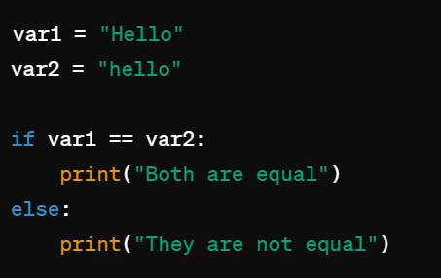
Fundamentals of Python – Syntax Rules
Python is case sensitive.-Python treats uppercase and lowercase characters as distinct, so Hello and hello are considered different identifiers.
Output: They are not equal

Slide 5

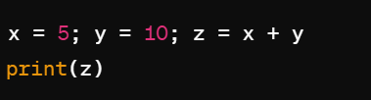
Fundamentals of Python – Syntax Rules
Python does not have a command terminator:-Unlike some other languages like C or Java, Python does not use a semicolon ; at the end of a statement. Instead, it relies on newline characters to terminate statements.
Each line can have one statement at most. For multiple statements, you should use a semicolon ‘;’

Slide 6
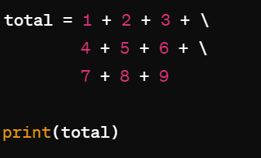
Fundamentals of Python – Syntax Rules
Comments in Python start with # or '''. For 1-line comments, we use # and for multiline use ''' (triple quotes either single or double):
Python supports multiline statements, i.e., Line Continuation. To do it, we put a backslash \ at the end of each line:
You can extend a statement across multiple lines using a backslash \

Slide 7
Key Benefits of Python for Data Science
Ease of Learning
Simple syntax and readability make it accessible for beginners.
Integration
Integrates well with other languages and tools, such as R, SQL, and Hadoop.
Productivity and Speed
Faster development and prototyping due to concise syntax and powerful libraries.
Community and Resources
Rich ecosystem with plenty of resources, tutorials, and third-party modules.

Slide 8
Basic Syntax
Variables
Definition: Containers for storing data values.
Example:
x = 10
name = "Alice"
Comments
Definition: Notes in the code that the interpreter ignores, used for explaining code.
Single-line comments: Use #
# This is a comment
x = 5 # This is also a comment
Multi-line comments: Use triple quotes ''' or """ for commenting out multiple lines
""" This is a multi-line comment or docstring. It can span across multiple lines and is often used to provide detailed explanations or documentation. """

Slide 9
Indentation
Purpose: Defines the structure and scope in Python. Consistent indentation is crucial.
Example:
if x > 0:
print("x is positive")
Data Types
1. Numeric Types
Integers (int)
Definition: Whole numbers, positive or negative, without decimals.
Examples:
x = 10
y = -3
Notes: Unlimited precision, can be used for counting, indexing, etc.

Slide 10
Floating-Point Numbers (float)
Definition: Numbers with a decimal point.
Examples:
pi = 3.14159
temperature = -42.5
Complex Numbers (complex)
Definition: Numbers with a real and an imaginary part.
Examples:
z = 2 + 3j
Notes: Used in scientific and engineering calculations.
2. Sequence Types
Strings (str)
Definition: Immutable sequences of Unicode characters.
Examples:
greeting = "Hello, World!"
Notes: Can be manipulated using various string methods (e.g., split(), join(), replace()).

Slide 11
Lists (list)
List is a versatile and mutable data structure that can contain a collection of items, including other lists, tuples, dictionaries, strings, integers, or any other Python data type.
Lists are ordered, meaning the items are stored in a specific sequence, and they allow duplicate elements.
Creation of Lists:
Lists can be created using square brackets [] or by using the list() constructor.
python
my_list = [1, 2, 3, 4, 5]
you can use the list() constructor to create a list from other iterable objects like tuples, strings, ranges, etc. Here are a few examples:
my_string = "hello"
my_list = list(my_string)
print(my_list) # Output: ['h', 'e', 'l', 'l', 'o']
my_range = range(5)
my_list = list(my_range)
print(my_list) # Output: [0, 1, 2, 3, 4]

Slide 12
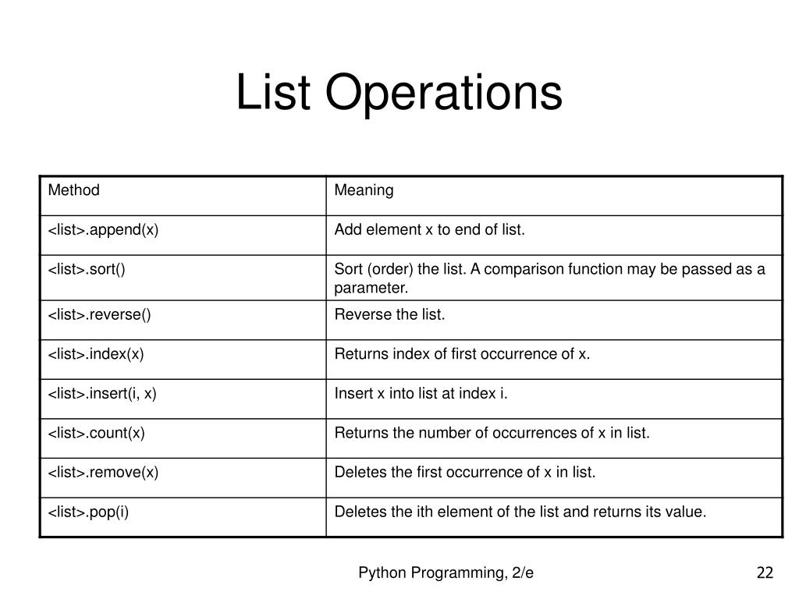
List Operations

Slide 13
Examples
# Creating a list
fruits = ["apple", "banana", "cherry"]
print("Original list:", fruits)
# Accessing list elements
print("First fruit:", fruits[0]) # Output: apple
print("Second fruit:", fruits[1]) # Output: banana
# Modifying list elements
fruits[1] = "blueberry"
print("Modified list:", fruits) # Output: ['apple', 'blueberry', 'cherry']
# Appending elements
fruits.append("orange")
print("After appending 'orange':", fruits) # Output: ['apple', 'blueberry', 'cherry', 'orange']
# Inserting elements
fruits.insert(1, "banana")
print("After inserting 'banana' at index 1:", fruits) # Output: ['apple', 'banana', 'blueberry', 'cherry', 'orange']
# Removing elements
fruits.remove("blueberry")
print("After removing 'blueberry':", fruits) # Output: ['apple', 'banana', 'cherry', 'orange']

Slide 14
Popping elements
removed_fruit = fruits.pop(2)
print("After popping element at index 2:", fruits) # Output: ['apple', 'banana', 'orange']
print("Removed fruit:", removed_fruit) # Output: cherry
Slicing lists
print("Slicing from index 1 to 3:", fruits[1:3]) # Output: ['banana', 'orange']
print("Slicing from start to index 2:", fruits[:2]) # Output: ['apple', 'banana']
# List length
print("Length of the list:", len(fruits)) # Output: 3
List concatenation
vegetables = ["carrot", "broccoli"]
all_foods = fruits + vegetables
print("Concatenated list:", all_foods) # Output: ['apple', 'banana', 'orange', 'carrot', 'broccoli']
Sorting a list
numbers = [4, 2, 9, 1]
numbers.sort()
print("Sorted list of numbers:", numbers) # Output: [1, 2, 4, 9]

Slide 15
Tuple
Tuple is an ordered collection of elements, similar to a list. However, unlike lists, tuples are immutable, meaning their elements cannot be changed after creation.
Tuples are commonly used for heterogeneous data, such as representing a fixed collection of related values.
Creation of Tuples:
Tuples are created using parentheses () or the tuple() constructor.
python
Example-
my_tuple = (1, 2, 3, 4, 5)
# Creating a tuple using the tuple() constructor
another_tuple = tuple(("apple", "banana", "cherry"))

Slide 16
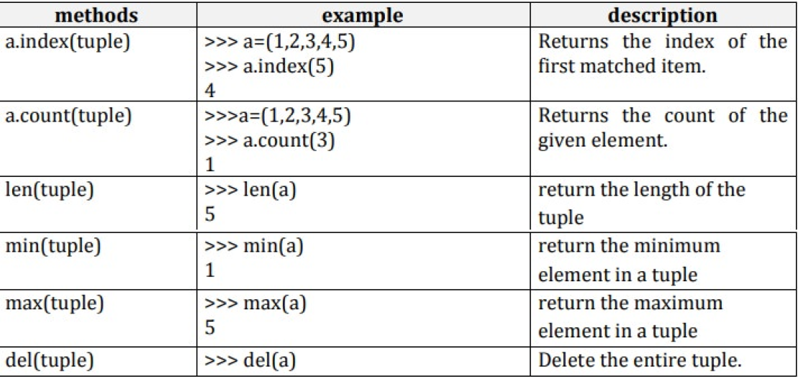

Slide 17
# Creating a tuple
fruits = ("apple", "banana", "cherry", "banana", "apple", "apple")
print("Original tuple:", fruits)
# Slicing tuples
print("Slicing from index 1 to 3:", fruits[1:3]) # Output: ('banana', 'cherry')
print("Slicing from start to index 2:", fruits[:2]) # Output: ('apple', 'banana')
# Tuple length
print("Length of the tuple:", len(fruits)) # Output: 6
# Finding the maximum and minimum elements
numbers = (5, 1, 8, 3, 9, 2)
print("Maximum value:", max(numbers)) # Output: 9
print("Minimum value:", min(numbers)) # Output: 1
# Counting occurrences of an element
apple_count = fruits.count("apple")
print("Number of 'apple' in the tuple:", apple_count) # Output: 3
# Deleting a tuple
# We can't delete individual elements, but we can delete the entire tuple
del fruits
# print(fruits) # This will raise an error because the tuple no longer exists

Slide 18
Dictionary
Dictionary is an unordered collection of items. Each item in a dictionary is stored as a key-value pair, where each key is unique and associated with a value.
Dictionaries are highly flexible and widely used for mapping between keys and values.
Creation of Dictionaries:
Dictionaries are created using curly braces {} or the dict() constructor.
# Creating a dictionary using curly braces
my_dict = {'name': 'John', 'age': 30, 'city': 'New York'}
# Creating a dictionary using the dict() constructor
another_dict = dict(name='Alice', age=25, city='London')

Slide 19
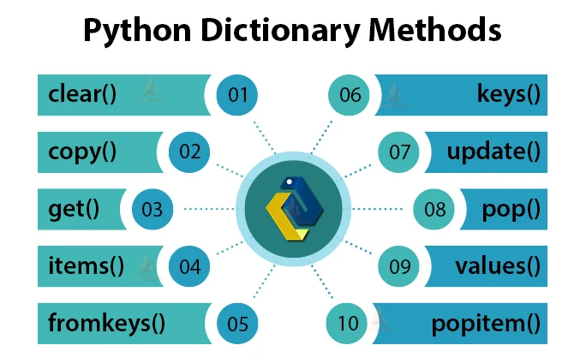

Slide 20
# Creating a dictionary
person = {
"name": "John",
"age": 30,
"city": "New York"
}
print("Original dictionary:", person)
# Accessing dictionary elements
print("Name:", person["name"]) # Output: John
print("Age:", person["age"]) # Output: 30
# Modifying dictionary elements
person["age"] = 31
print("Modified age:", person) # Output: {'name': 'John', 'age': 31, 'city': 'New York'}
# Adding new elements
person["email"] = "john@example.com"
print("After adding email:", person) # Output: {'name': 'John', 'age': 31, 'city': 'New York', 'email': 'john@example.com'}

Slide 21
# Removing elements
del person["city"]
print("After deleting city:", person) # Output: {'name': 'John', 'age': 31, 'email': 'john@example.com'}
# Using pop method to remove an element
email = person.pop("email")
print("After popping email:", person) # Output: {'name': 'John', 'age': 31}
print("Popped email:", email) # Output: john@example.com
# Getting the length of the dictionary
print("Length of the dictionary:", len(person)) # Output: 2
# Merging two dictionaries
additional_info = {"city": "Los Angeles", "occupation": "Engineer"}
person.update(additional_info)
print("After merging with additional_info:", person)
# Output: {'name': 'John', 'age': 31, 'city': 'Los Angeles', 'occupation': 'Engineer'}
# Clearing all elements from the dictionary
person.clear()
print("After clearing the dictionary:", person) # Output: {}

Slide 22
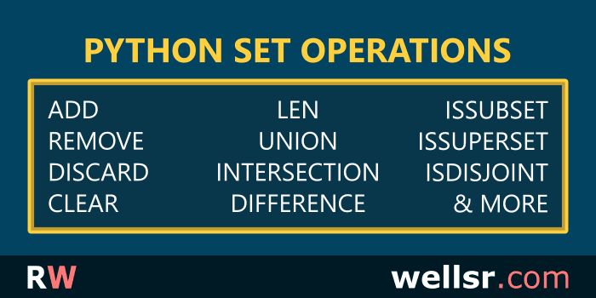
4. Set Types
Sets (set)
Definition: Unordered collections of unique items.
Examples:
unique_numbers = {1, 2, 3, 4, 5}
Notes: Supports mathematical set operations like union, intersection, difference.

Slide 23
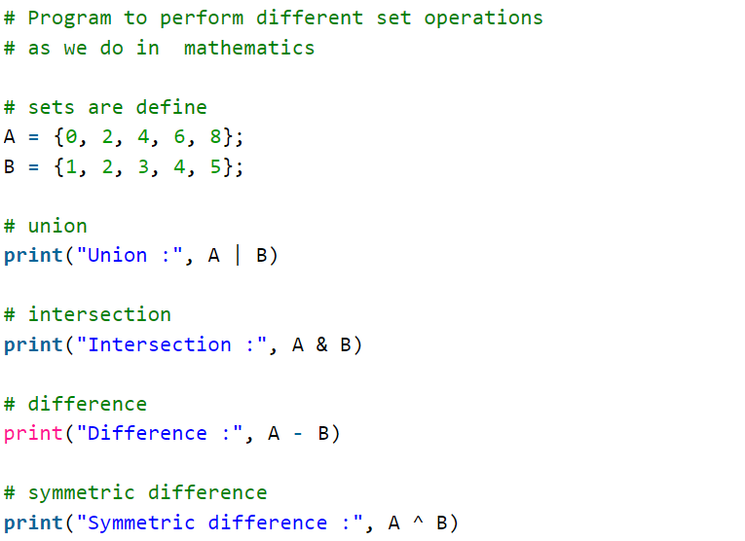
OUTPUT
('Union :', set([0, 1, 2, 3, 4, 5, 6, 8]))
('Intersection :', set([2, 4]))
('Difference :', set([8, 0, 6]))
('Symmetric difference :', set([0, 1, 3, 5, 6, 8]))

Slide 24
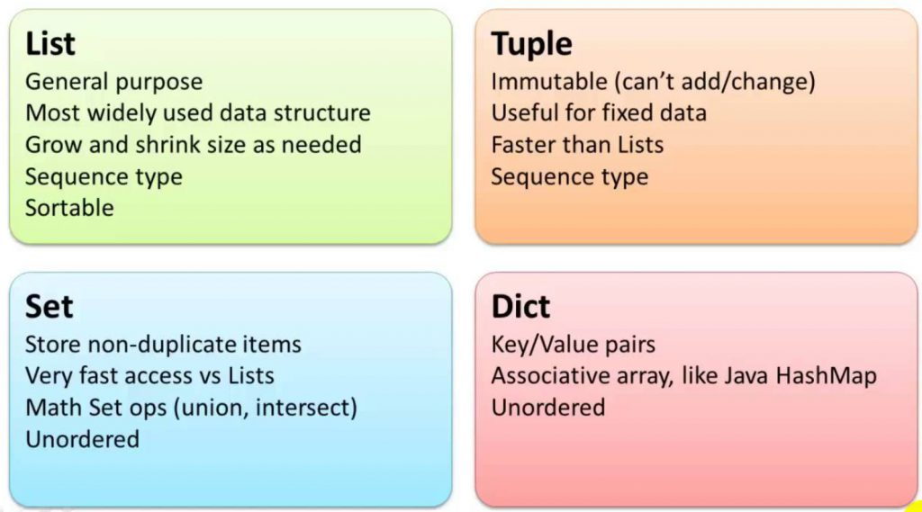

Slide 25
Control Flow
Conditional Statements
Exception Handling
Mastering decision-making is crucial in programming. Python's if-elif-else statements let you execute different code blocks based on specific conditions, creating dynamic and responsive applications.
Anticipating and managing errors is crucial in programming. Python's try-except blocks let you handle exceptions gracefully, ensuring robust and reliable code even with unexpected inputs or system failures.
1
2
3
Loops
for and while loops automate repetitive tasks and efficiently process data. Whether iterating over a list, range, or data structure, loops unlock Python's data manipulation power.

Slide 26
FOR LOOP
The for loop is typically used when you know how many times you want to iterate or when you want to iterate over a sequence (like a list or tuple).
Syntax:
for item in sequence:
# Body of the loop
my_list = [1, 2, 3, 4, 5]
my_string = "Python"
# Iterate through the list using a for loop
print("Iterating through the list:")
for item in my_list:
print(item)
# Iterate through the string using a for loop
print("\nIterating through the string:")
for char in my_string:
print(char)
OUTPUT
Iterating through the list:
1
2
3
4
5
Iterating through the string:
P
y
t
h
o
n

Slide 27
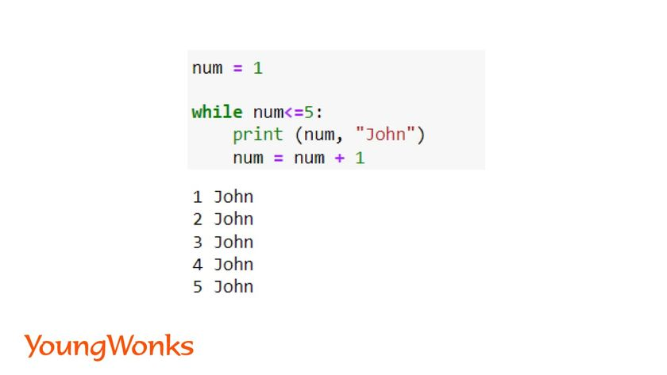
While loop
The while loop is used when you want to execute a block of code repeatedly as long as a condition is true. It's typically used when the number of iterations is not known in advance.
Syntax:
while condition:
# Body of the loop

Slide 28
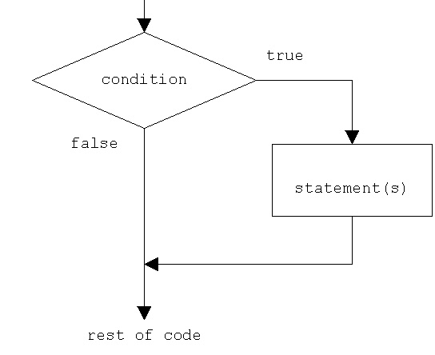
Conditional statements
Conditional statements in Python are used to execute different blocks of code based on certain conditions. The main conditional statements in Python are:
if Statement: Executes a block of code if a specified condition is true.
Example-
temperature = 30
# Check if the temperature is above 25 degrees Celsius
if temperature > 25:
print("It's a hot day.")
OUTPUT
It’s a hot day

Slide 29
2.if-else Statement: Executes one block of code if the condition is true and another block if the condition is false.
age = 20
# Check if the person is eligible to vote
if age >= 18:
print("You are eligible to vote.")
else:
print("You are not eligible to vote.")
OUTPUT
You are eligible to vote.

Slide 30
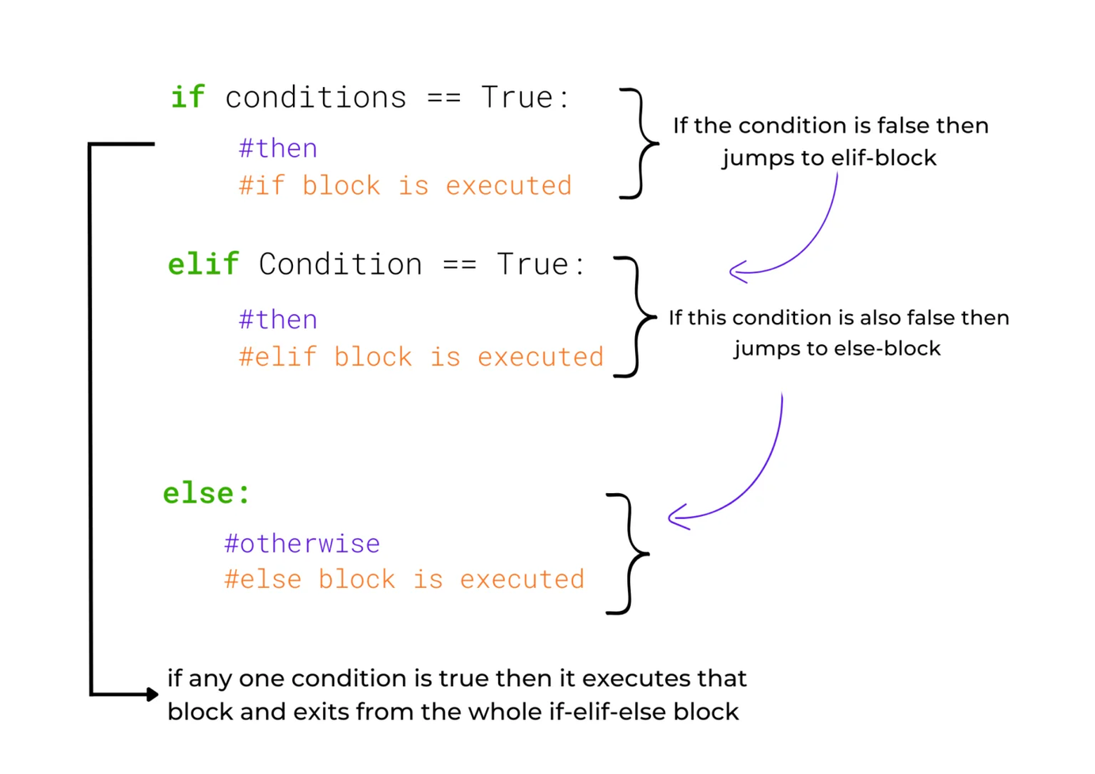
3. if-elif-else Statement: Allows checking multiple conditions. Executes the block of code associated with the first true condition. If none of the conditions are true, the else block (if provided) is executed.

Slide 31

# Get the user's age as input
age = int(input("Please enter your age: "))
# Determine the category based on age
if age < 13:
print("You are a child.")
elif age < 18:
print("You are a teenager.")
elif age < 65:
print("You are an adult.")
else:
print("You are a senior citizen.")
OUTPUT
Please enter your age: 30
You are an adult.

Slide 32
4.Nested if Statement: Allows using if statements inside other if statements.
python
# Get the user's score and age as input
score = int(input("Please enter your test score: "))
age = int(input("Please enter your age: "))
# Determine eligibility for admission
if score >= 70:
if age >= 18:
print("You are eligible for admission.")
else:
print("You are not eligible for admission due to age requirement.")
else:
print("You are not eligible for admission due to low test score.")
OUTPUT
Please enter your test score: 75
Please enter your age: 19
You are eligible for admission.

Slide 33
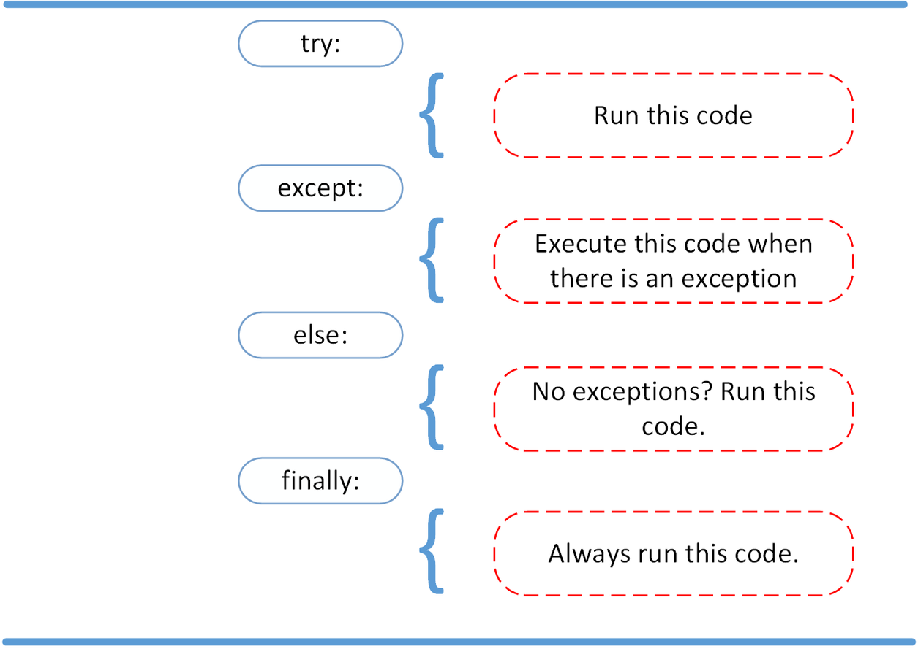
Exception handling in Python allows you to gracefully handle errors that occur during program execution. It ensures that your program doesn't crash unexpectedly and provides mechanisms to handle errors and continue execution or gracefully exit.

Slide 34
try:
# Get the user's input
numerator = int(input("Enter the numerator: "))
denominator = int(input("Enter the denominator: "))
# Perform division
result = numerator / denominator
except ZeroDivisionError:
# Handle division by zero
print("Error: Division by zero is not allowed.")
except ValueError:
# Handle invalid input
print("Error: Invalid input. Please enter valid integers.")
else:
# Execute if no exception occurs
print("The result of the division is:", result)
finally:
# Execute no matter what (whether an exception occurs or not)
print("Thank you for using the division calculator.")
OUTPUT
Enter the numerator: 10
Enter the denominator: 0
Error: Division by zero is not allowed.
Thank you for using the division calculator.

Slide 35
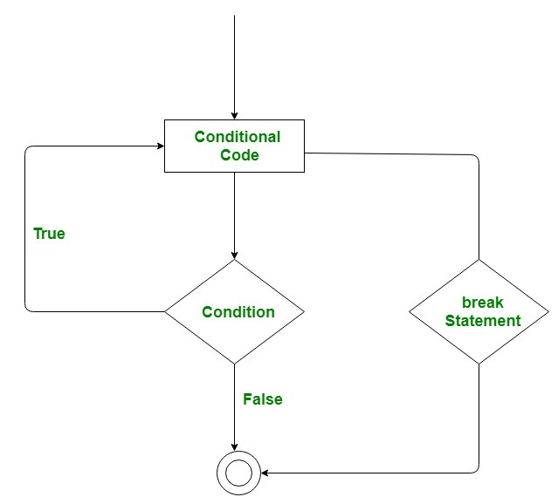
Break Statement in Python
The break statement in Python is used to terminate the loop or statement in which it is present. After that, the control will pass to the statements that are present after the break statement
Syntax of Break Statement
The break statement in Python has the following syntax:
for / while loop:
# statement(s)
if condition:
break
# statement(s)
# loop end

Slide 36
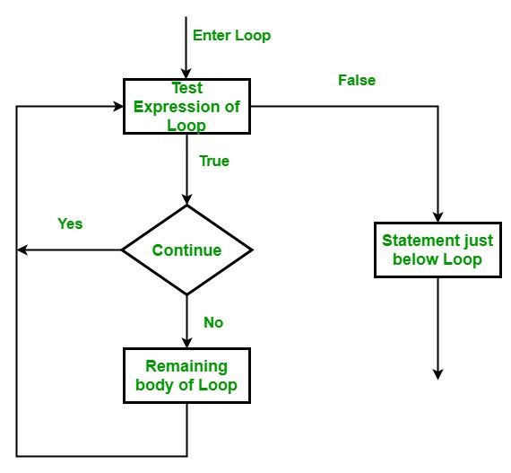
Continue Statement in Python
Continue is also a loop control statement just like the break statement. continue statement is opposite to that of the break statement, instead of terminating the loop, it forces to execute the next iteration of the loop.
Syntax of Continue Statement
The continue statement in Python has the following syntax:
for / while loop:
# statement(s)
if condition:
continue
# statement(s)

Slide 37
print("Example of using break and continue:")
# Loop from 1 to 10
for i in range(1, 11):
# Check if the number is divisible by 3
if i % 3 == 0:
# Skip printing this number
continue
# Check if the number is greater than 7
if i > 7:
# Stop the loop
break
# Print the number
print(i)
Output
Example of using break and continue:
1
2
4
5
7

Slide 38
Pass Statement in Python
As the name suggests pass statement simply does nothing. The pass statement in Python is used when a statement is required syntactically but you do not want any command or code to execute.
# Define a function that does nothing
def do_nothing():
pass
# Loop through a range of numbers
for i in range(5):
# Check if the number is odd
if i % 2 != 0:
# If odd, do nothing
pass
else:
# If even, print the number
print(i)
OUTPUT
Example of using the pass statement:
0
2
4

Slide 39
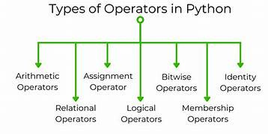
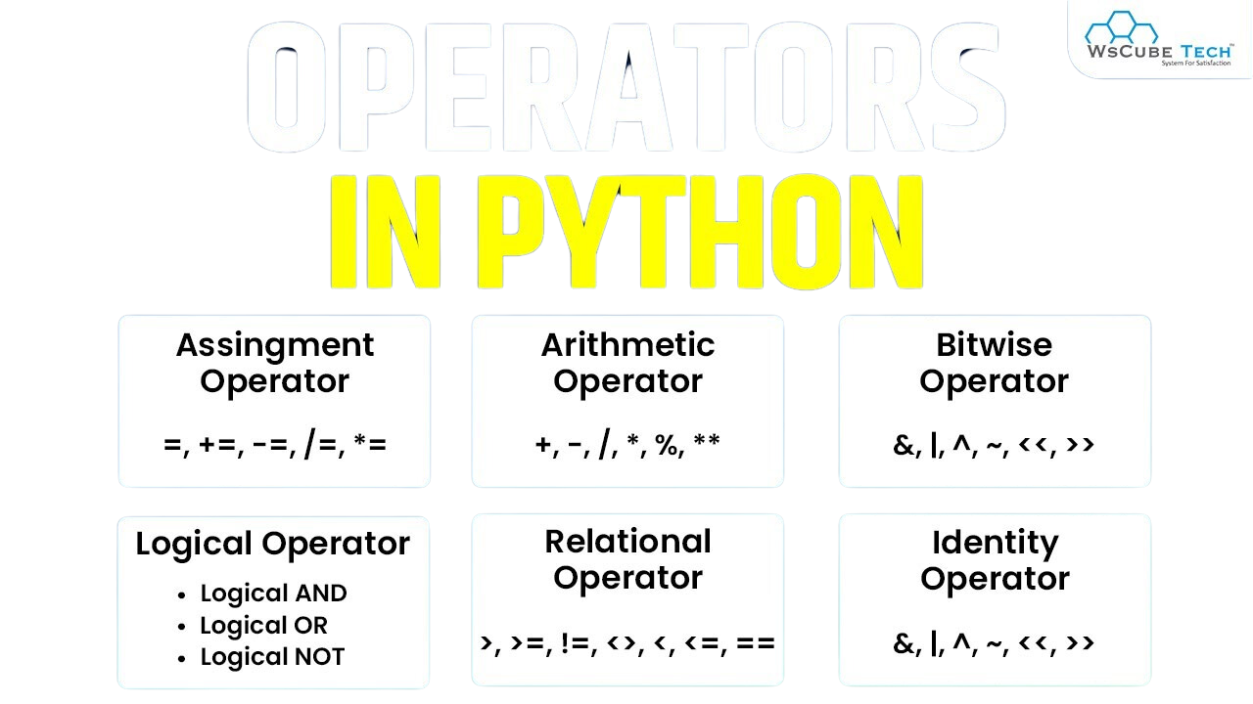

Slide 40
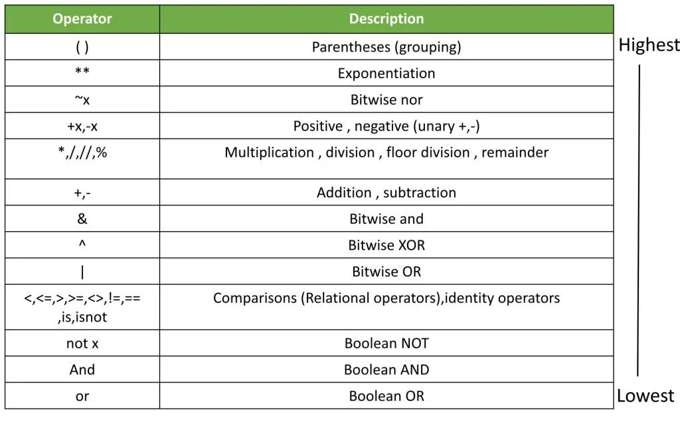
Python operator Precedence

Slide 41
Membership operators
The membership operators in Python are used to test if a sequence (such as a string, list, tuple, set, or dictionary) contains a certain value.
There are two membership operators:
in: Returns True if the value is found in the sequence.
not in: Returns True if the value is not found in the sequence.
# List of numbers
numbers = [1, 2, 3, 4, 5]
# Check if 3 is in the list
if 3 in numbers:
print("3 is in the list.")
else:
print("3 is not in the list.")
OUTPUT
3 is in the list.

Slide 42
Identity operators
The is identity operators in Python is used to evaluate whether two variables do not refer to the same object in memory. It's the negation of the is operator.
a is not b: Returns True if a and b do not refer to the same object in memory.
a is b: Returns True if a and b refer to the same object in memory.
list1 = [1, 2, 3]
list2 = [1, 2, 3]
# Create a reference to list1
list3 = list1
# Compare list1 and list2 using 'is'
print(list1 is list2) # Output: False, because they are different objects
# Compare list1 and list3 using 'is'
print(list1 is list3) # Output: True, because list3 is a reference to list1
# Compare list1 and list2 using 'is not'
print(list1 is not list2) # Output: True, because they are different objects

Slide 43
Functions in python
map()
The map() function iterates through all items in the given iterable and executes the function we passed as an argument on each of them.
The syntax is : map(function, iterable(s))
You have a list of original prices, and you want to reduce each price by 20%. You can use the map function to apply the discount to each price in the list.
original_prices = [100, 200, 300, 400, 500]
# Define a function to apply a 20% discount
def apply_discount(price):
return price * 0.8
# Use map to apply the discount to all prices
discounted_prices = list(map(apply_discount, original_prices))
# Print the original and discounted prices
print("Original prices:", original_prices)
print("Discounted prices:", discounted_prices)
output
Original prices: [100, 200, 300, 400, 500]
Discounted prices: [80.0, 160.0, 240.0, 320.0, 400.0]

Slide 44
Functions in python
filter()
Filters elements from an iterable (e.g., list) based on a given function and returns an iterator containing the elements for which the function returns true.
The syntax is : filter(function, iterable(s))
def is_even(x):
return x % 2 == 0
num = [1, 2, 3, 4, 5, 6, 7, 8, 9, 10]
even_nums = filter(is_even, num)
print(list(even_nums))
# Output: [2, 4, 6, 8, 10]

Slide 45
Functions in python
lambda()
Lambda functions, also known as anonymous functions, are small, inline functions defined using the lambda keyword without a function name.
The syntax is : lambda arguments: expression
Imagine you have a list of numbers, and you want to create a new list containing the squares of these numbers.
# List of numbers
numbers = [1, 2, 3, 4, 5]
# Use map to create a list of squares of the numbers
squares = list(map(lambda x: x ** 2, numbers))
# Print the list of squares
print("Squares of the numbers:", squares)

Slide 46
Functions in python
reduce()
Applies a function of two arguments cumulatively to the items of an iterable, reducing it to a single value.
The syntax is: reduce(function, sequence[, initial])
from functools import reduce
def add(x, y):
return x + y
numbers = [1, 2, 3, 4, 5]
sum = reduce(add, numbers)
print(sum) # Output: 15

Slide 47
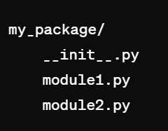
Packages
In Python, a package is a collection of modules organized in directories. A package can contain subpackages, modules, and even sub-subpackages, forming a hierarchical structure. Packages are used to organize and distribute Python code in a structured manner.
Creating Packages:
To create a package, you need to organize your Python code into directories and include __init__.py files in each directory to indicate to Python that the directory is a package.
For example, let's say we want to create a package named my_package with two modules module1.py and module2.py. The directory structure would look like this:

Slide 48
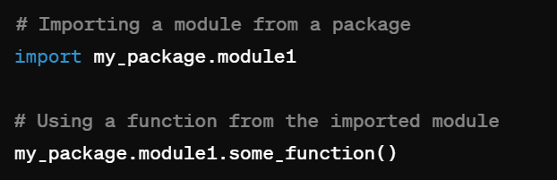
Importing Packages and Modules:
You can import modules and packages in your Python scripts using the import statement.
Installing Packages:
Python packages can be installed using package managers like pip, which fetches packages from the Python Package Index (PyPI) repository.
code-
pip install package_name

Slide 49
Popular Python Packages:
There are thousands of Python packages available for various purposes. Some popular ones include:
NumPy: Scientific computing and numerical operations.
Pandas: Data manipulation and analysis.
Matplotlib: Plotting and visualization.
TensorFlow, PyTorch: Machine learning and deep learning frameworks.
Django, Flask: Web development frameworks.
Requests: HTTP library for making HTTP requests.
BeautifulSoup, Scrapy: Web scraping libraries.

Slide 50
File Handling :
File handling in Python is the process of reading and writing data to and from a file stored in a computer system. The built-in open() function is used to open a file and perform operations on it.
Here are the steps involved in file handling in Python :
r: open an existing file for a read operation.
w: open an existing file for a write operation. If the file already contains some data, then it will be overridden but if the file is not present then it creates the file as well.
a: open an existing file for append operation. It won’t override existing data.
r+: To read and write data into the file. The previous data in the file will be overridden.
w+: To write and read data. It will override existing data.
a+: To append and read data from the file. It won’t override existing data.

Slide 51
Opening a File
You can open a file using the built-in open() function. It takes two parameters: the file path and the mode in which you want to open the file ('r' for reading, 'w' for writing, 'a' for appending, and 'r+' for reading and writing).
# Open a file for reading
file = open("example.txt", "r")
Reading from a File
You can read the contents of a file using methods like read(), readline(), or readlines().
# Read the entire file
content = file.read()
print(content)
# Read one line at a time returns it as a string
line = file.readline()
print(line)
# Read all lines returns them as a list of strings, where each string is a line from the file, including the newline character (\n) at the end of each line.
lines = file.readlines()
print(lines)

Slide 52
Writing to a File
You can write to a file using the write() method.
# Open a file for writing
file = open("example.txt", "w")
# Write content to the file
file.write("Hello, world!\n")
Closing a File
It's important to close a file after you're done working with it using the close() method.
# Close the file
file.close()
Using with Statement
You can use the with statement to automatically close the file when you're done with it. It's a cleaner and more Pythonic way of working with files.
with open("example.txt", "r") as file:
content = file.read()
print(content)

Slide 53
To access functions or packages defined in one file from another file in Python, you can use the import statement.
Example
file2.py
file1.py:
def greet(name):
return f"Hello, {name}!"
def add(a, b):
return a + b
# Importing specific functions from file1
from file1 import greet, add
# Using the imported functions
name = "Alice"
print(greet(name)) # Output: Hello, Alice!
result = add(3, 5)
print(result) # Output: 8
Importing the Entire Module: You can import the entire module and use the module name to call the functions.
import file1
name = "Alice"
print(file1.greet(name)) # Output: Hello, Alice!
result = file1.add(3, 5)
print(result) # Output: 8

Slide 54
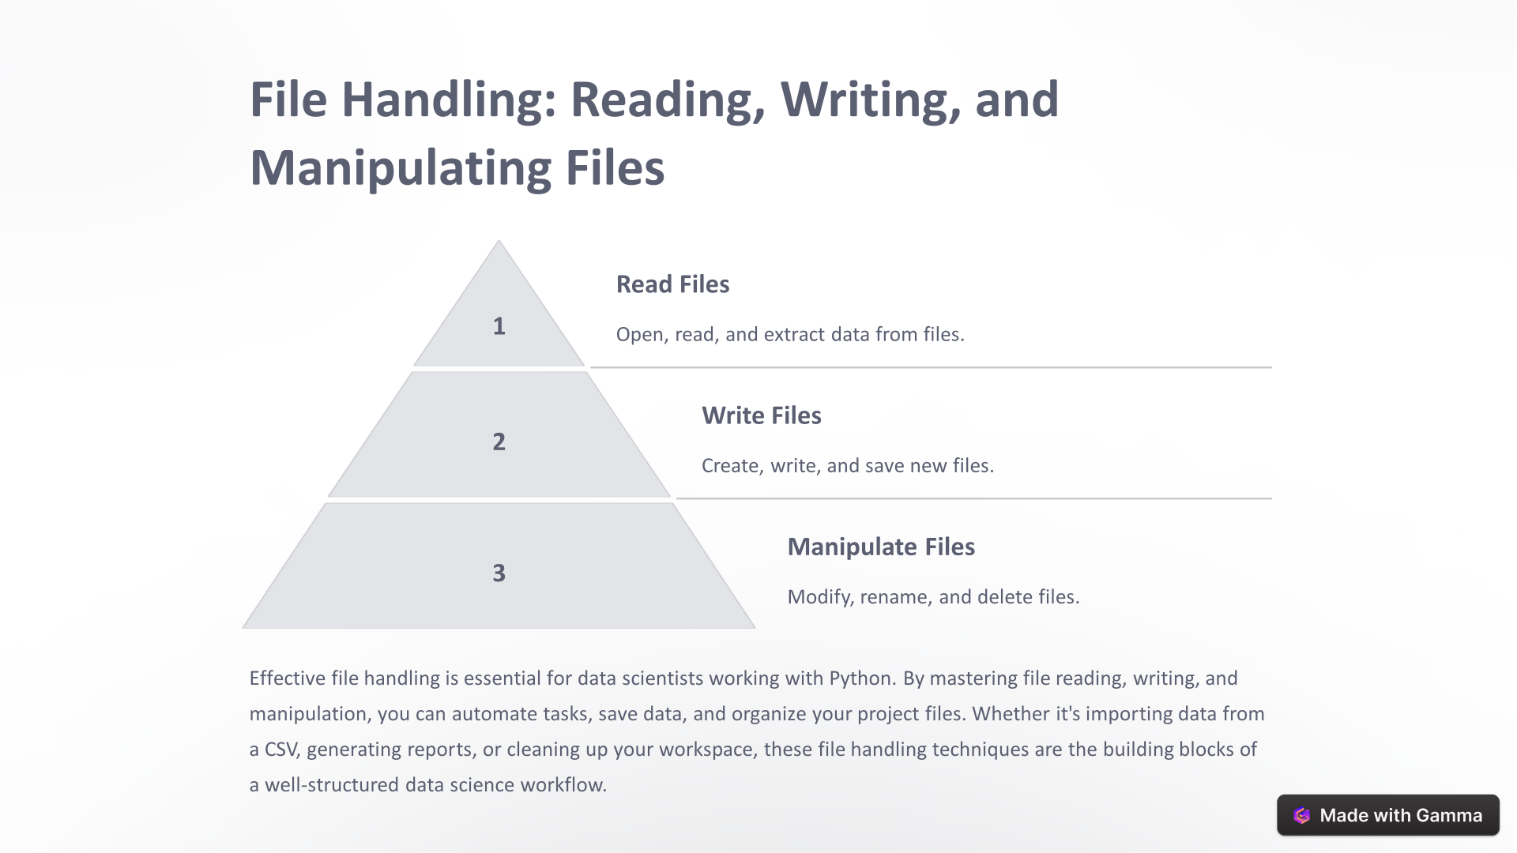

Slide 55
Thank you

